Slide 1
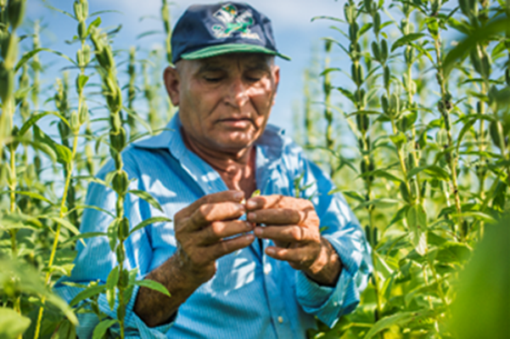
What is it?
Quinoa
Sesame seeds
Peanuts
www.shared-interest.com

Slide 2
What is it?
Sesame seeds
www.shared-interest.com

Slide 3
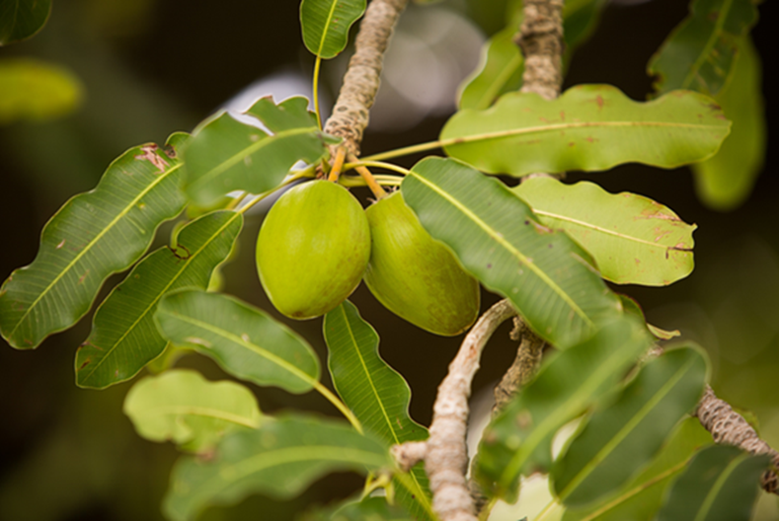
What is it?
Shea nuts (used to make shea butter)
Coffee bean
Mango
www.shared-interest.com

Slide 4
What is it?
Shea nuts (used to make shea butter)
www.shared-interest.com

Slide 5
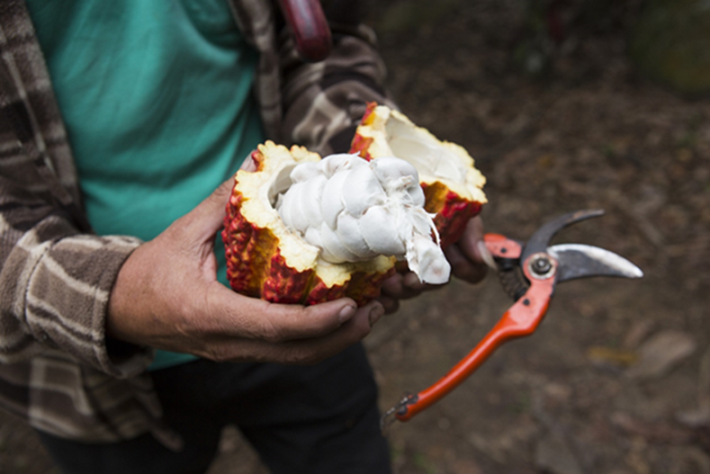
What is it?
Kidney beans
Cocoa
Dragon fruit
www.shared-interest.com

Slide 6
What is it?
Cocoa
www.shared-interest.com

Slide 7
What is it?
Mango
Tomato
Cashew nut
www.shared-interest.com

Slide 8
What is it?
Cashew nut
www.shared-interest.com

Slide 9
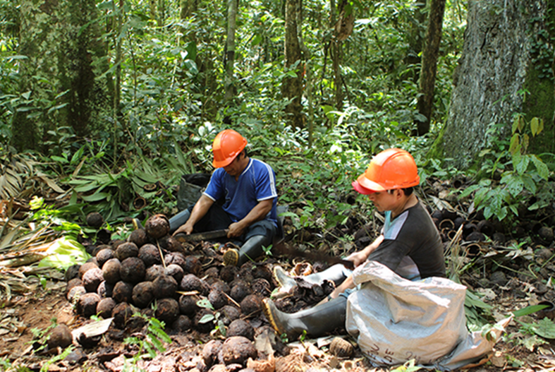
What is it?
Brazil nuts
Coconuts
Bananas
www.shared-interest.com

Slide 10
What is it?
Brazil nuts
www.shared-interest.com

Slide 11
What is it?
Green beans
Bananas
Vanilla pods
www.shared-interest.com

Slide 12
What is it?
Vanilla pods
www.shared-interest.com

